Slide 1

Sysops Squad System
Created by ArchElekt Team
Christian Schweikert - Vincent Elcrin - Steffen Hoening - Sebastitan Titakis
Notes:
Penultimate Electronics, a large electronics giant, is in trouble.
Customers are complaining!
If nothing is done soon, they will be forced to abandon this business and fire all of the experts. Hi, I am Christian and I will walk you through the solution brought to us by ArchElekt.

Slide 2
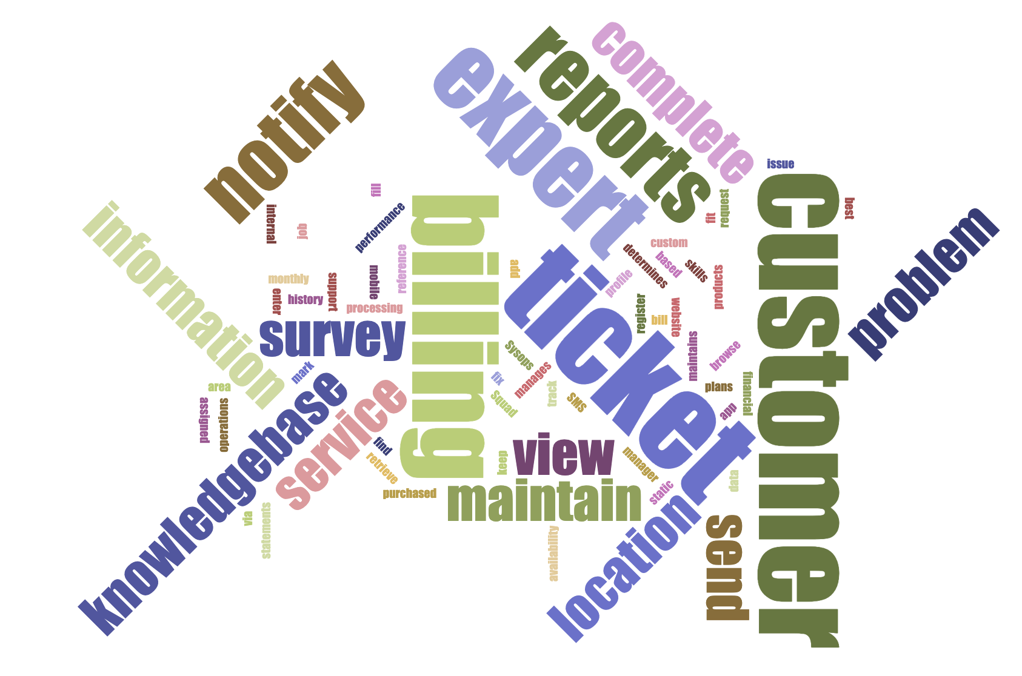
Monolithic application
Notes:
The current system is a large monolith that was built many years ago.
It supports ticket workflow, reporting, users administration, billing process to name a few.

Slide 3

Notes:
Although, the system has problems…

Slide 4
Customers are complaining that oftentimes
the wrong expert
shows up to fix something they know nothing about. 🤷‍♂️ 🤬
Notes:
Too often the wrong expert shows up.
With this you will get very famous in social media... but what could be a reason for this?

Slide 5
Experts' profile information like their
skill sets
are added and maintained in the system through an
administrator
🧑‍💼
Notes:
Well in the current solution, Experts' skills are added and maintained by an administrator This might be not ideal.

Slide 6
Wrong skill sets
stored
😑
Notes:
What if the information is outdated? The expert can't even tell.

Slide 7

Notes:
A solution for this could be rather simple.

Slide 8

Enable expert to
self-manage
profile information like skill sets
🗂
Notes:
Why not allowing the expert to maintain their own skills. They should know best.

Slide 9

Notes:
But there is more complains.

Slide 10
Customers and call-center staff complained that the system
freezes-up
or sometimes is unavailable
😴
Reliability, Availability
Notes:
The system sometimes freezes-up or is unavailable.
Hum.. That's sounds pretty bad and probably adds to the customer frustration. There is a few reasons for that though, let's break that down.

Slide 11
Usage Spike caused by customers
📈
Elasticity
Notes:
The team mentioned usage spikes as a reason. Hum.. might be although we don't know as we don't have any evidences.

Slide 12
Reporting
📝
Notes:
Reporting could be causing extreme load in the system
And affecting core functionalities.

Slide 13

Notes:
Anyway, those are wild guesses. We actually don't know for sure.

Slide 14
Invest in
monitoring
solutions
🧐
Observability
Notes:
If you can’t measure it, you can’t improve it
Let’s invest in monitoring and do some proper analysis.

Slide 15

Notes:
More complains?
So far the team reported availability and reliability problems, are more complains?

Slide 16
System is hard to change
🛠
Maintainability
Notes:
The team reported that whenever a change is made, it takes too long and something else usually breaks. This is probably due to the strong coupling between components that emerged from the monolithic system.

Slide 17

Notes:
So how can we solve this?

Slide 18
Split the monolith
🪚
Notes:
Divide and conquer strategy will help us to improve code maintainability and address the availability problems

Slide 19
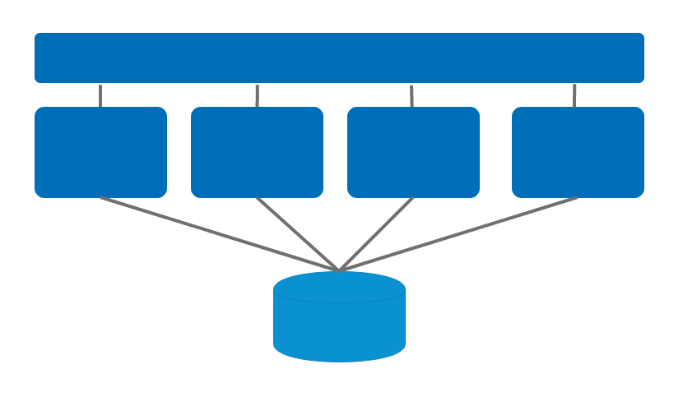
Service-based architecture
Notes:
From all the options we chose the service-based architecture. Now we can quickly introduce services without the need of splitting the database.

Slide 20
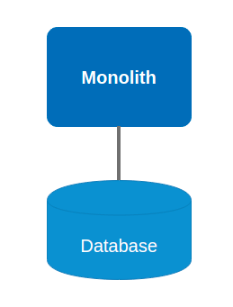
Notes:
>CLICK<
First add an API Gateway to decouple the frontend from the backend. And allow the decomposition of the monolith in services.
This will increase flexibility and testability.

Slide 21
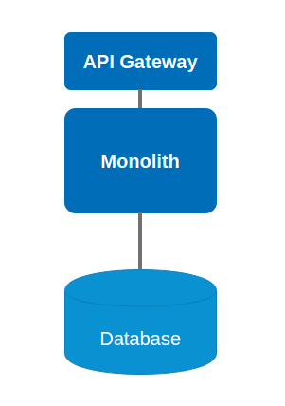
API Gateway as single point of contact
Notes:
>CLICK<
First add an API Gateway to decouple the frontend from the backend. And allow the decomposition of the monolith in services.
This will increase flexibility and testability.

Slide 22
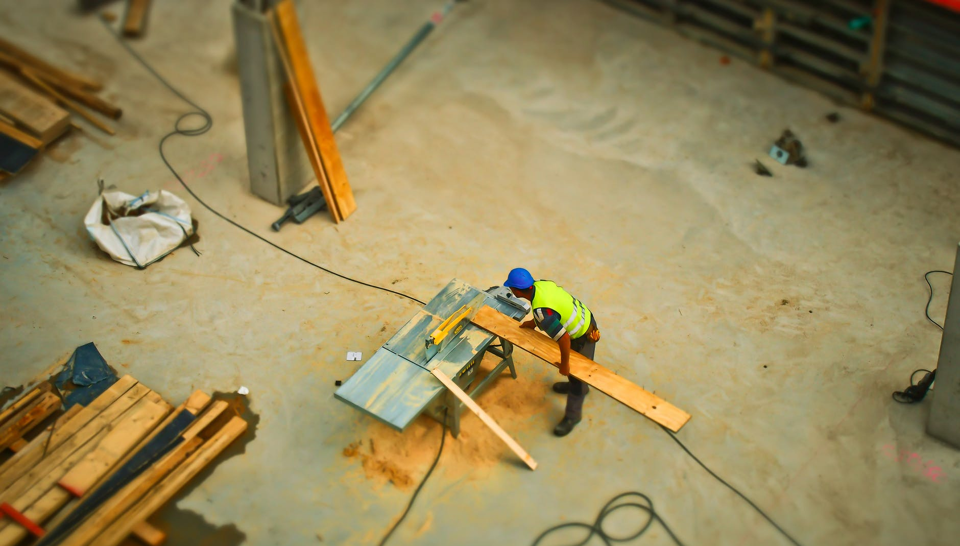
Notes:
Now, which service should we split first?

Slide 23
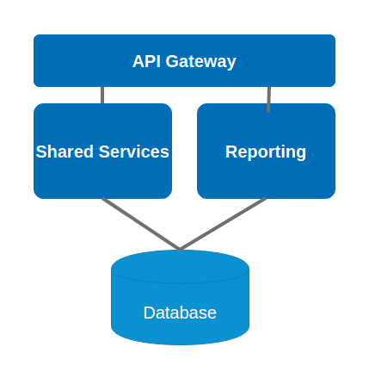
Monolith
Notes:
>CLICK<
By allocating reporting in its own service, spikes in resource consumption will not impact other functionality. This will avoid that the whole system freezes.

Slide 24
Segregate reporting into a separate service
Monolith
Notes:
>CLICK<
By allocating reporting in its own service, spikes in resource consumption will not impact other functionality. This will avoid that the whole system freezes.

Slide 25

what else could improve code maintainability and availability?
Notes:
What else might improve code maintainability and availability?

Slide 26
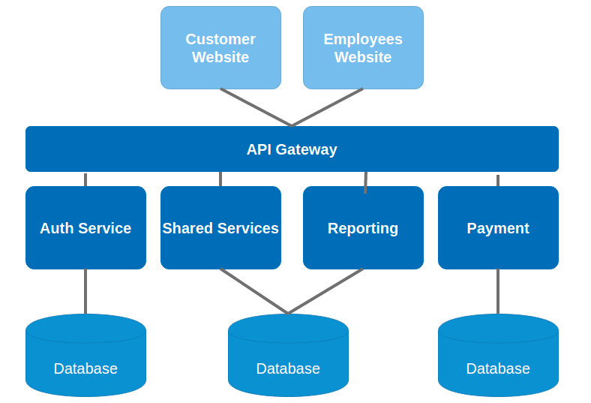
Website
Employee Website
Customer Website
Shared Services
Reporting
Notes:
>CLICK<
Customers and Employees will have a dedicated website. This will allow the team to develop each website independently.

Slide 27
Customer and employee websites
Customer Website
Employee Website
Shared Services
Reporting
Notes:
>CLICK<
Customers and Employees will have a dedicated website. This will allow the team to develop each website independently.

Slide 28
Authentication and payment service with dedicated database
Customer Website
Employee Website
Shared Services
Reporting
Notes:
More security is gained by segregating authentication and payment into independent services. This will reduce the chance of passwords or credit card numbers being stolen.

Slide 29

Notes:
Are we done?
The last problem customers mentioned is pretty annoying

Slide 30
Customers are complaining that experts are never showing up due to lost tickets
🕵️
Notes:
Of course, we are talking about ticket loss. But why are we loosing tickets?

Slide 31
Data loss 😭
Notes:
Ticket might just disappear from the system, if the communication between components fails for example.

Slide 32
Right skills are not available 🍳
Notes:
Also sometimes, the right expert might not be available because of vacation or sickness.

Slide 33
SMS & pushing ticket information to expert is unreliable 📨
Notes:
Pushing ticket information to the expert in general sounds pretty unreliable.
Also, what about feedback from the experts?

Slide 34

Notes:
Any ideas?

Slide 35
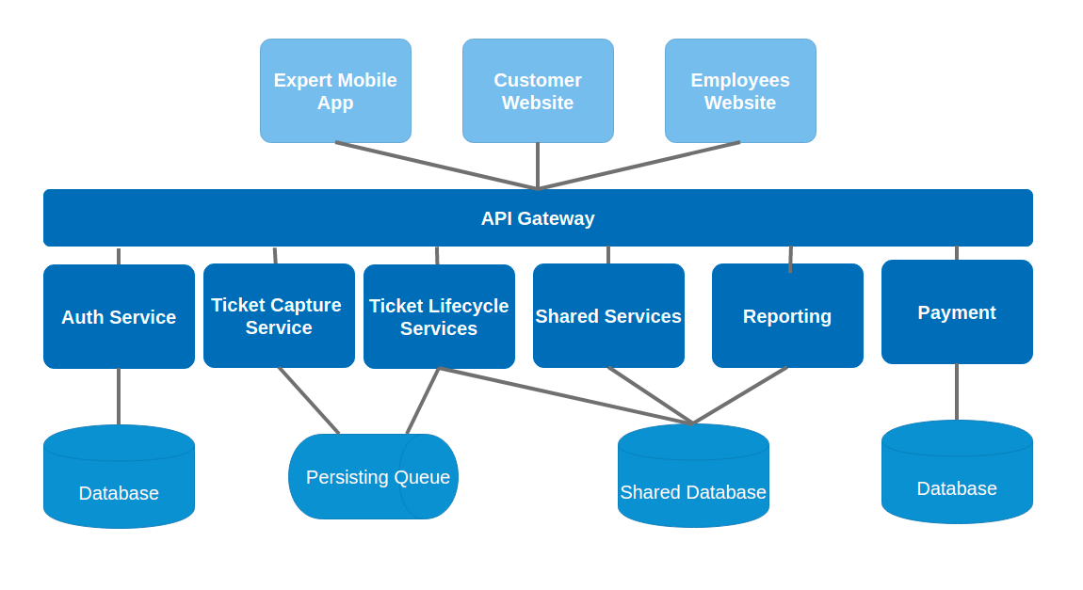
Shared Services
Notes:
>CLICK<
In the current system it is not clear how we ensure tickets are captured.
A Ticket Capture component with a persisting queue will guarantee that no ticket gets lost.

Slide 36
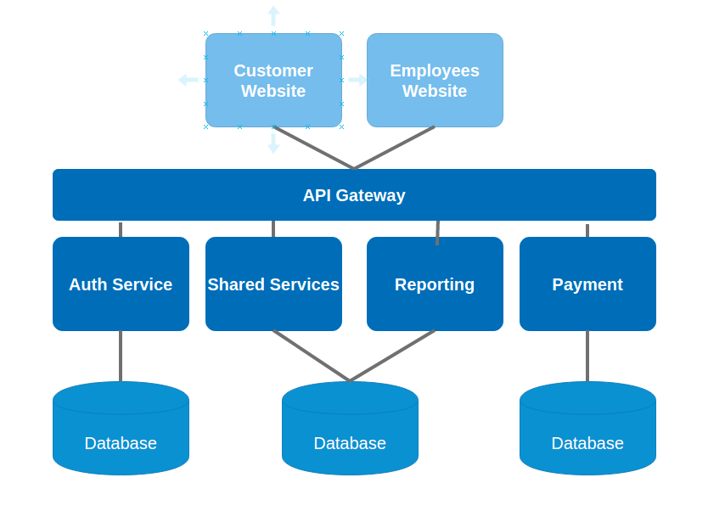
Ticket Capture & Persisting
Shared Services
Notes:
>CLICK<
In the current system it is not clear how we ensure tickets are captured.
A Ticket Capture component with a persisting queue will guarantee that no ticket gets lost.

Slide 37
Ticket Workflow
Expert Approval
🙏💘
Notes:
As next step we improved the ticket workflow.
Experts now will have the chance to accept or reject a ticket.

Slide 38
Ticket Workflow
Escalation
❤️‍🔥😱
Notes:
And if the system fails to assign a ticket, we introduced an escalation process.

Slide 39
Shared Services
Notes:
Although, there is a piece missing that is responsible for handling and orchestrating all that logic
>CLICK<
That's why we decided to create a new component responsible for the whole ticket life-cycle.

Slide 40
Ticket Lifecycle
Shared Services
Notes:
Although, there is a piece missing that is responsible for handling and orchestrating all that logic
>CLICK<
That's why we decided to create a new component responsible for the whole ticket life-cycle.

Slide 41
Shared Services
Notes:
And this is it. The whole system

Slide 42
OUR
DESIGN PRINCIPALS
🪄
Notes:
What led us to this solution?

Slide 43
Simple and pragmatic
🥦
Notes:
Our solution simply fills a couple of gaps in the existing system.

Slide 44
Priority to fixing
🍊
Notes:
Yes, we have a system.
So let's take reasonable steps and fix the critical pieces first.

Slide 45
Flexibility for future improvement
🍻
Notes:
We'll get more flexibility which is key for any future improvement.

Slide 46
More secure
🌶
Notes:
...and we improve security whenever we see a chance!

Slide 47


Thanks for watching
ArchElekt 🤓
https://github.com/stitakis/ArchElekt
Notes:
Thanks for watching

